Slide 1
Telecom Churn
File created on: 3/12/2026 2:04:10 AM

Slide 2
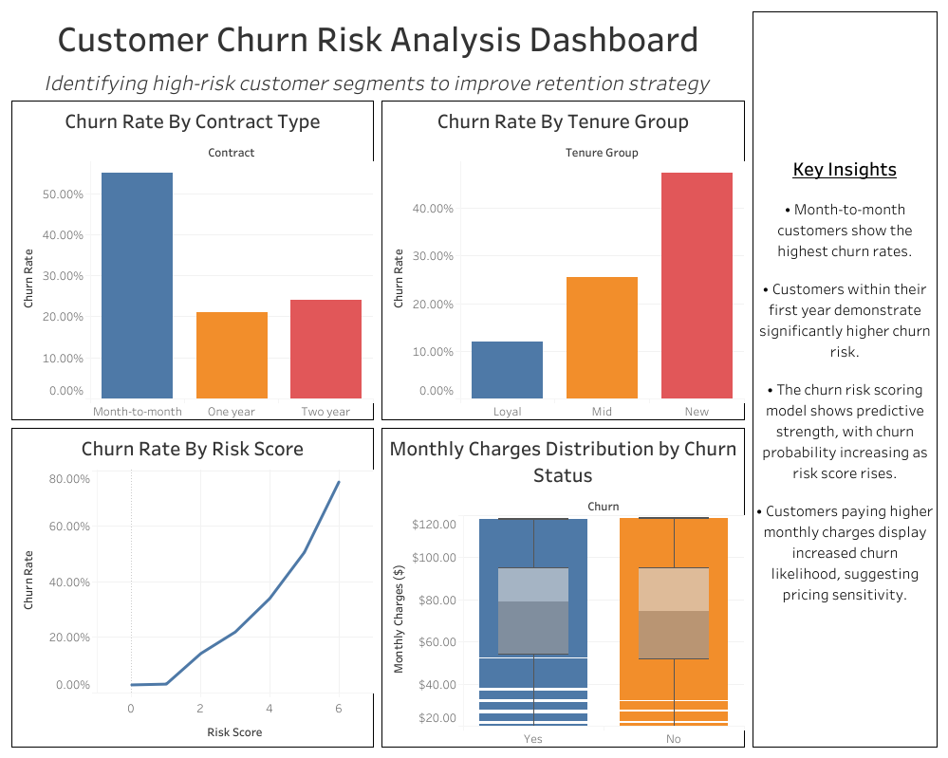

Slide 3
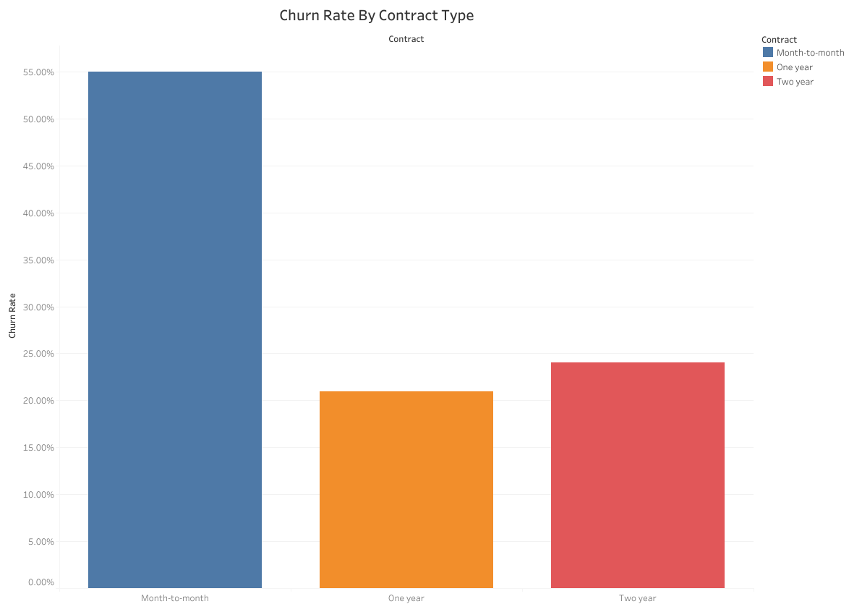

Slide 4
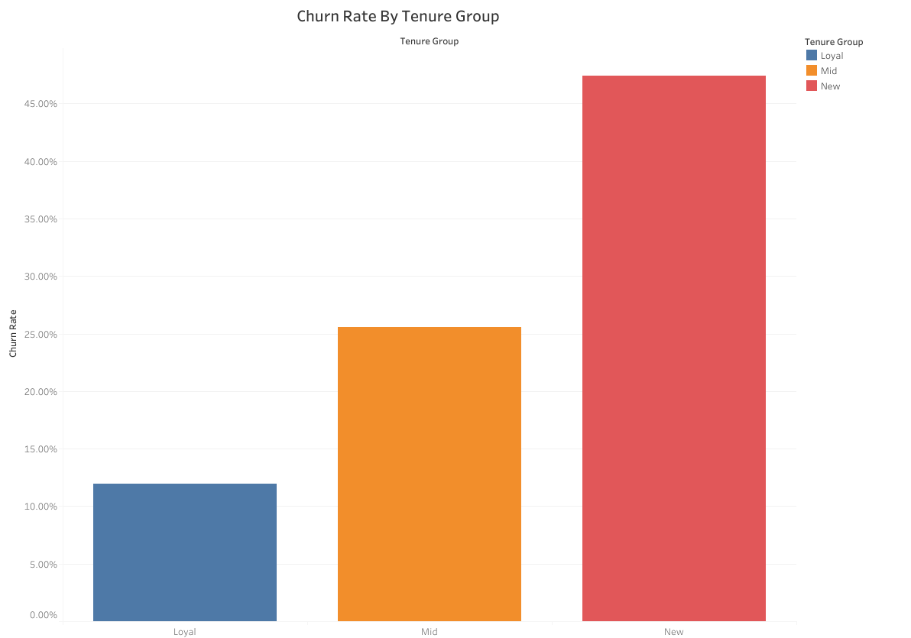

Slide 5
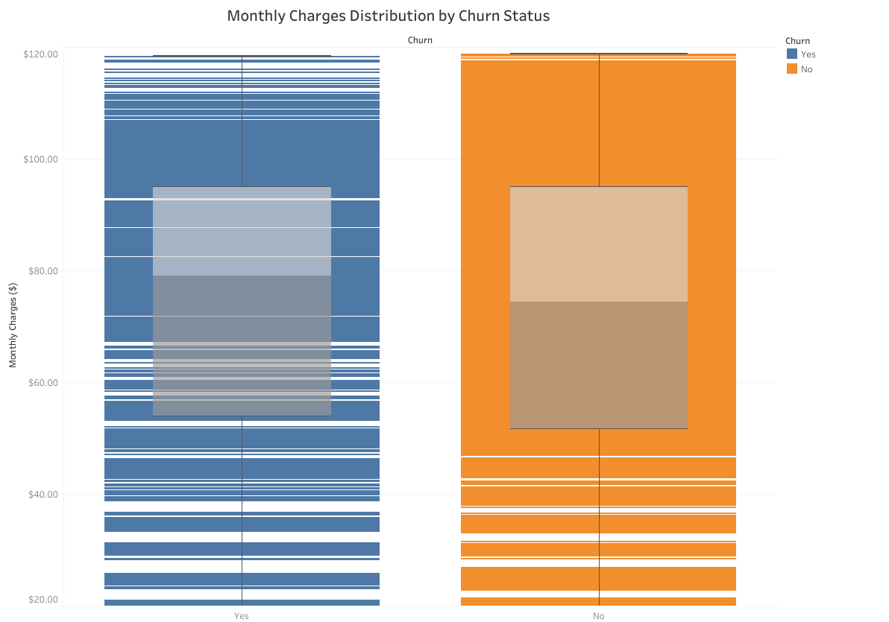

Slide 6
